Slide 1
Lyft Earnings Commitment Verification
Add a brief explanation of the presentation’s purpose

Slide 2
Numbered list
1 | Data Collection insight on Lyft’s earning commitment and the data collection process.
2 | Data Cleaning Cleaning and normalization for data analysis
3 | Commitment Verification calculating the validity behind lyft’s Earning Commitment
4 | Visualizations Python visualizations
5 | Conclusion Final interpretation

Slide 3
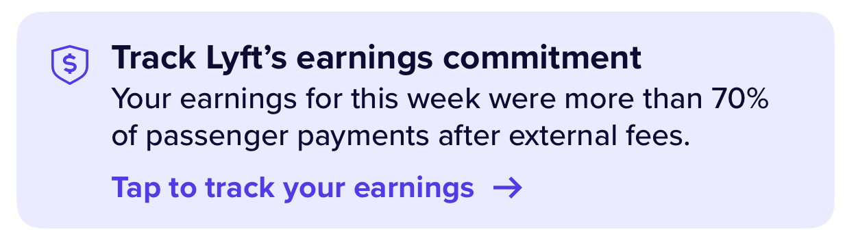
Lyft’s Earnings Commitment
“On a weekly basis, drivers will earn 70% or more of passenger payments after external fees are deducted.”
“Note: Drivers will always receive 100% of tips, adjustments, benefits, and tolls, as they aren't subject to external fees or Lyft's fee.”
https://help.lyft.com/hc/en-us/all/articles/9785135090-earnings-commitment

Slide 4
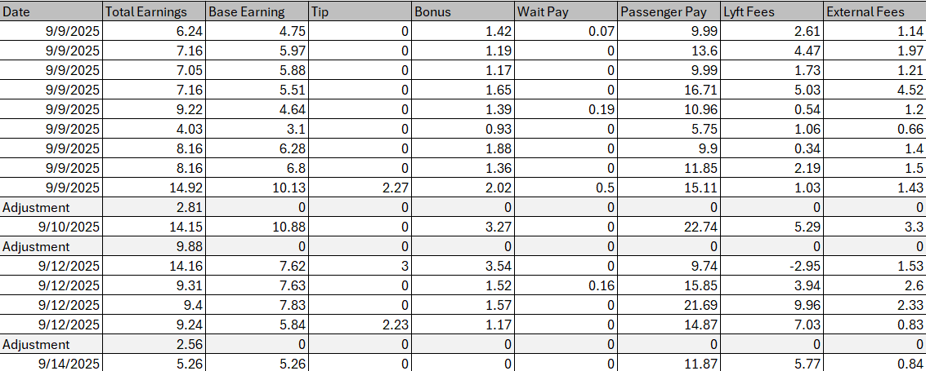
Data Collection
I created a basic Excel CSV file containing the payment and fee information from the week (9/8/2025 – 9/15/2025)

Slide 5
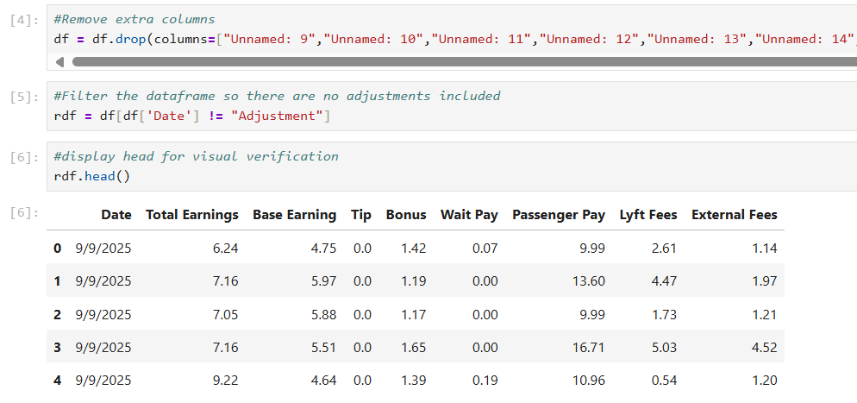
Data Cleaning
I removed extra columns that were displaying empty values in my dataframe
I separated the rides from the adjustments and saved them as separate dataframe called “rdf”

Slide 6
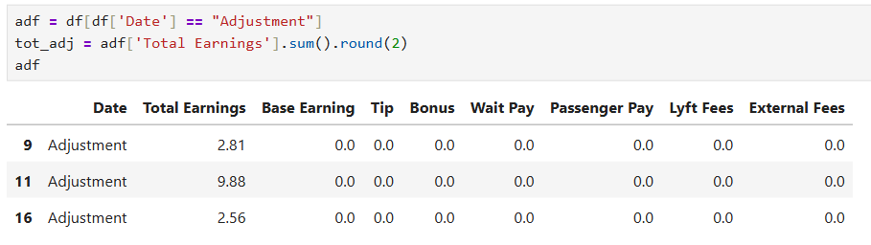
Data Cleaning
I also saved the adjustments as their own dataframe called “adf”
I used this dataframe to find the total I was paid in adjustments

Slide 7
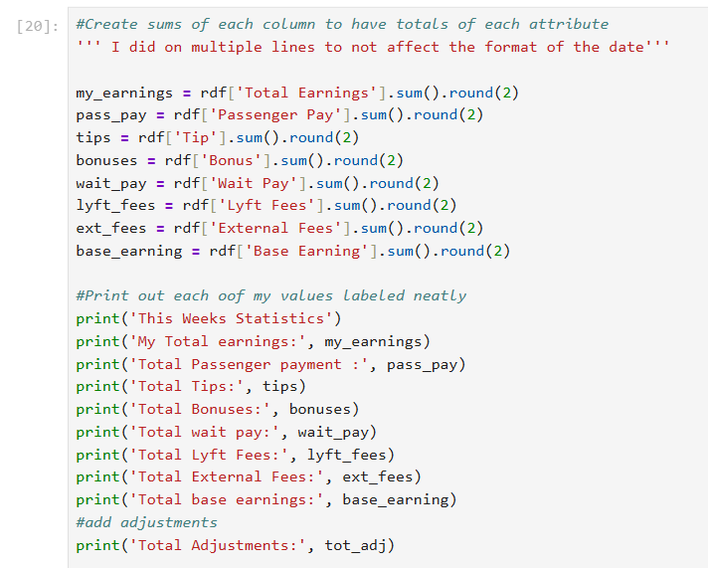
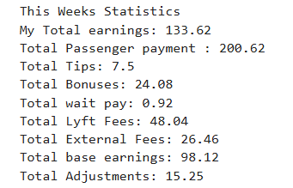
Calculations

Slide 8
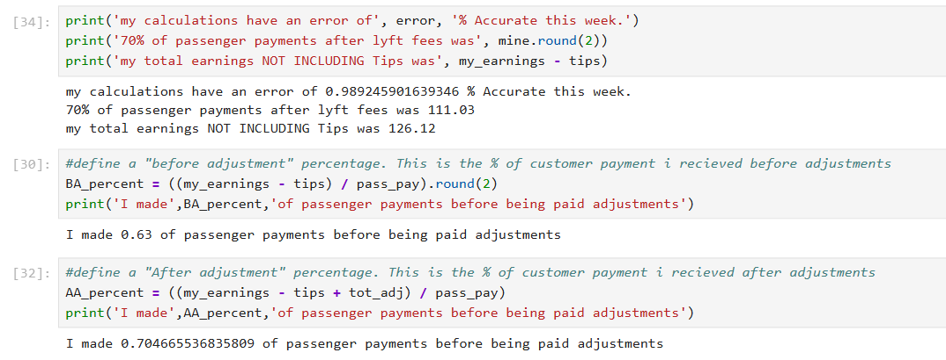
Calculations cont.

Slide 9
Conclusion
Before adjustments (and not including tips), I did NOT make 70% of the passenger payments. I received only 63% of what the customer was paid
After I received my adjustment from Lyft (still not including tips), I earned a total of 70.4% of the customers payment.
This confirms that Lyft paid me an acceptable amount in accordance with the “Earning Commitment Guarantee”

Slide 10
Visualizations

Slide 11
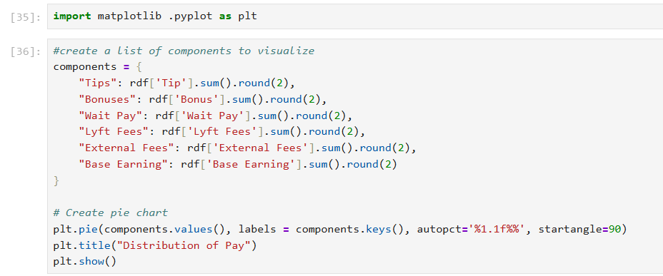
Pie Chart - Code

Slide 12
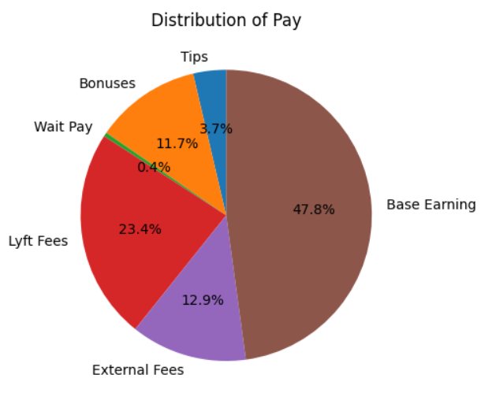
Pie Chart

